Slide 1


IEI Student Chapter
AI-Powered Offline Intelligent
Soil Fertility & Irrigation Advisor
using Raspberry Pi and ESP32
Theme: AI, IoT & Embedded Systems for Agriculture and Rural Development
Team: Pranitha D Salian · Samuel Jesten Serrao · Prathik J Hegde · Sachin Shetty
Guides: Dr. Chandrakantha T S & Dr. Madhwaraj K G (HOD)
Mangalore Institute of Technology and Engineering (MITE) — MCA Dept.
Badaga Mijar, Near Moodabidre, Mangaluru, Karnataka – 574225
1 / 12

Slide 2

Introduction & Problem Statement
Why does precision agriculture need AI?
The Problem
Our Solution
58 %+ of India's rural population depends on agriculture
Yield losses from over-fertilization & poor irrigation
Delayed soil lab results take days to weeks
No internet in remote farm locations
Existing tools require cloud — unusable offline
Real-time multi-parameter soil sensor (RS485 Modbus)
ESP32 MCU collects & transmits data over local Wi-Fi
Raspberry Pi runs 4 AI models — fully offline
Results on LCD, web dashboard & SMS alert
No cloud, no internet needed — works anywhere
MITE — MCA | AI Smart Agriculture | 2025–26
2 / 12

Slide 3
Objectives
Seven goals driving the project
Multi-Parameter Sensing
SMS Alert System
01
Real-time Moisture, Temperature, EC, pH via Modbus RS485 sensor
05
SIM800L GSM delivers results to farmer mobile phones
Train 4 AI Models
02
Crop, Fertility, Fertilizer & Irrigation classifiers using ML
LCD On-Field Display
06
16×2 I2C LCD shows live readings without any extra device
Offline Edge Inference
03
Deploy models on Raspberry Pi — zero internet dependency
Rural Deployment Ready
04
Local Web Dashboard
07
Auto-refreshing UI accessible over local Wi-Fi hotspot
Affordable, scalable solution for remote agricultural regions
MITE — MCA | AI Smart Agriculture | 2025–26
3 / 12

Slide 4
System Block Diagram
Three-layer IoT → Edge AI → Output architecture
SENSING LAYER
NPK+THEC
Soil Sensor
MAX485
Module
ESP32 MCU
16×2 LCD
Display
RS485
UART2
Wi-Fi · Modbus Master
HTTP Client · LCD
I2C
Moisture·Temp
EC·pH
RS485↔TTL
GPIO4 RE/DE
I2C 0x27
Live readings
HTTP POST · Wi-Fi LAN
EDGE AI LAYER
Crop
Model
Fertility
Model
Fertilizer
Model
Irrigation
Model
Raspberry Pi
Flask API Server
Random Forest
>90%
Decision Tree
>88%
Random Forest
>87%
Gradient Boost
>91%
/predict /get_data
/send_sms
OUTPUT LAYER
Suggested Crop
Fertility Level
Fertilizer Type
Irrigation Advisory
SMS (SIM800L)
Web Dashboard
Hardware/Sensing
AI Models
Raspberry Pi
Outputs
SMS
Web
MITE — MCA | AI Smart Agriculture | 2025–26
4 / 12

Slide 5






Hardware Components
Six key hardware elements and their roles
NPK+THEC Soil Sensor
MAX485 Module
RS485 Modbus RTU · Slave ID 2 · 9600 baud
TTL ↔ RS485 · RE/DE → GPIO 4
Reads Moisture, Temperature, Electrical Conductivity, pH simultaneously
Half-duplex RS485 bus control — switches between TX and RX modes
ESP32 Dev Board
Raspberry Pi 3B+/4
240 MHz Dual-core · Built-in Wi-Fi & BT
ARM Cortex · Linux · Flask · scikit-learn
Reads sensor via Modbus Master, sends JSON HTTP POST to Raspberry Pi
Edge AI server — runs 4 ML models and serves local web dashboard
SIM800L GSM Module
16×2 I2C LCD Display
/dev/serial0 · 9600 baud · AT commands
I2C address 0x27 · 5V · 16 chars × 2 rows
Sends SMS alerts with AI predictions to farmer mobile numbers
Shows live sensor readings on-field without requiring any screen device
MITE — MCA | AI Smart Agriculture | 2025–26
5 / 12

Slide 6
Sensor Communication — Modbus RS485
How ESP32 reads the 4-parameter soil sensor
Modbus Register Map
ESP32 Firmware Flow
Register
Parameter
Unit
Scale
Example
1
Read 4 Modbus Registers
readHoldingRegisters(0x0000, 4)
0x0000
Moisture
%RH
Value ÷ 10
250 → 25.0%
2
Scale Raw Values
÷10 for moisture/temp/pH
0x0001
Temperature
°C
Value ÷ 10
280 → 28.0°C
3
Display on 16×2 LCD
T:28°C pH:7.3 EC:320 M:25%
0x0002
EC
µS/cm
Raw value
320 → 320
4
Build JSON Payload
{temperature, moisture, ec, ph}
0x0003
Soil pH
pH
÷10 if >14
73 → 7.3
5
HTTP POST to Raspberry Pi
http://pi_ip:5000/predict
Baud: 9600 · Format: 8N1 · Slave ID: 2 · RE/DE: GPIO 4 (HIGH=TX, LOW=RX)
6
Wait 3s → Repeat
Loop continues indefinitely
MITE — MCA | AI Smart Agriculture | 2025–26
6 / 12

Slide 7
Machine Learning Models
Four offline classifiers trained on soil parameters
Crop Recommendation
Soil Fertility Model
Algorithm: Random Forest Classifier
>90%
Algorithm: Decision Tree Classifier
>88%
Features: Moisture, Temperature, EC, pH
Features: Moisture, Temperature, EC, pH
Output: Rice · Wheat · Cotton · Sugarcane · etc.
Accuracy
Output: High · Medium · Low
Accuracy
Serialized with joblib · LabelEncoder for inverse_transform
Serialized with joblib · LabelEncoder for inverse_transform
Fertilizer Recommendation
Irrigation Advisory
Algorithm: Random Forest Classifier
>87%
Algorithm: Gradient Boosting Classifier
>91%
Features: Moisture, Temperature, EC, pH
Features: Moisture, Temperature, EC, pH
Output: Urea · DAP · NPK 10-26-26 · etc.
Accuracy
Output: Irrigate Now · Moderate · No Irrigation
Accuracy
Serialized with joblib · LabelEncoder for inverse_transform
Serialized with joblib · LabelEncoder for inverse_transform
MITE — MCA | AI Smart Agriculture | 2025–26
7 / 12

Slide 8
Flask REST API & Web Dashboard
Raspberry Pi server endpoints and live monitoring
API Endpoints
🌱 AI Smart Agriculture Dashboard
Moisture
Temperature
GET
/
34.2 %
27.8 °C
Serves auto-refreshing HTML dashboard
EC
pH
POST
/predict
420 µS/cm
6.8
Receives JSON sensor data; runs 4 AI models; returns predictions
Crop
Fertility
GET
/get_data
🌾 Rice
Medium
Returns latest sensor + prediction data (polled every 3s by JS)
Fertilizer
Irrigation
POST
/send_sms
DAP
Irrigate Now
Accepts mobile number; sends SMS alert via SIM800L AT commands
Auto-refreshes every 3 seconds via JavaScript fetch()
MITE — MCA | AI Smart Agriculture | 2025–26
8 / 12

Slide 9
SMS Alert System — SIM800L GSM
Delivering AI predictions to farmer mobile phones
SMS Delivery Flow
📱 SMS Message Preview
1
Farmer Enters Mobile Number
AI SMART AGRICULTURE RESULT
Moisture : 34.2 %
Temperature : 27.8 C
EC : 420
pH : 6.8
Crop : Rice
Fertility : Medium
Fertilizer : DAP
Irrigation : Irrigate Now
Via web dashboard on any browser
2
POST /send_sms Triggered
Flask receives mobile number from form
3
AT+CMGF=1 (Text Mode)
GSM module set to SMS text mode
4
AT+CMGS="+91XXXXXXXXXX"
Target phone number sent to SIM800L
5
Message Body Transmitted
Sensor values + 4 AI predictions
6
Ctrl+Z (0x1A) → SMS Sent
Delivery confirmed within 10 seconds
MITE — MCA | AI Smart Agriculture | 2025–26
9 / 12

Slide 10
Results & System Performance
Measured outcomes across all components
System Performance Metrics
>90%
>88%
>87%
>91%
HTTP Latency (ESP32→Pi)
<500 ms
Crop Model
Accuracy
Fertility
Accuracy
Fertilizer
Accuracy
Irrigation
Accuracy
Full AI Inference (4 models)
<1 second
LCD Refresh Cycle
Every 5 s
Web Dashboard Refresh
Every 3 s
SMS Delivery
<10 seconds
Modbus Error Detection
Within 3 s
All components passed integration testing
MITE — MCA | AI Smart Agriculture | 2025–26
10 / 12

Slide 11
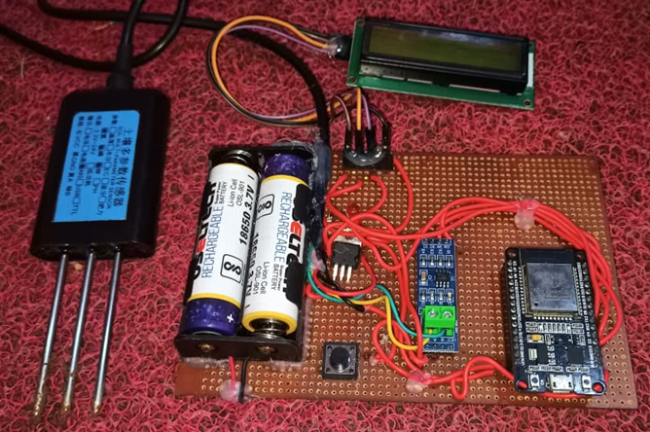
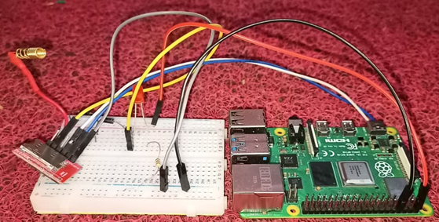
Experimental Output
Fig 1. Soil Sensor and ESP-32 Unit
Fig 2. Raspberry pi and SIM800L Unit
MITE — MCA | AI Smart Agriculture | 2025–26
10 / 12

Slide 12
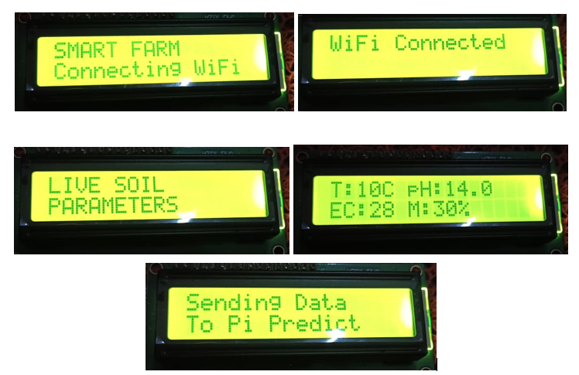
Experimental Output
Fig 3. Initialization of ESP-32 Unit
MITE — MCA | AI Smart Agriculture | 2025–26
10 / 12

Slide 13
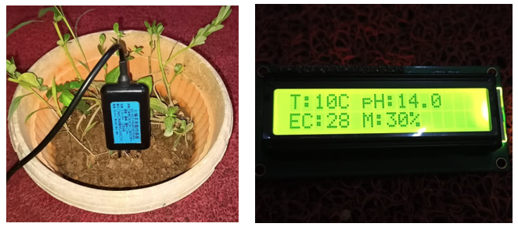
Experimental Output
Sample Output1:
MITE — MCA | AI Smart Agriculture | 2025–26
10 / 12

Slide 14
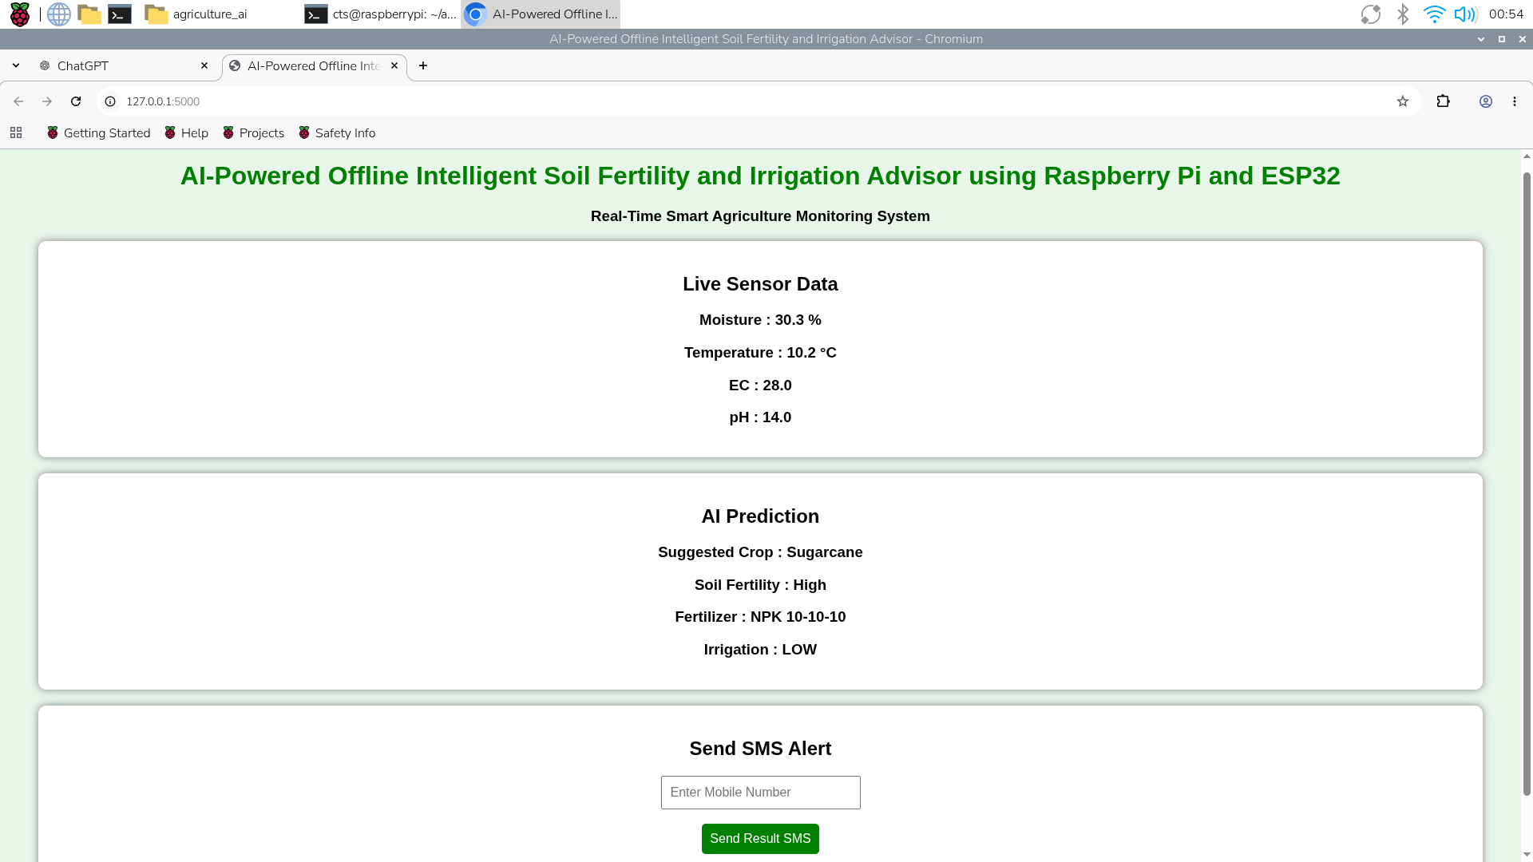
Experimental Output
Sample Output1:
MITE — MCA | AI Smart Agriculture | 2025–26
10 / 12

Slide 15
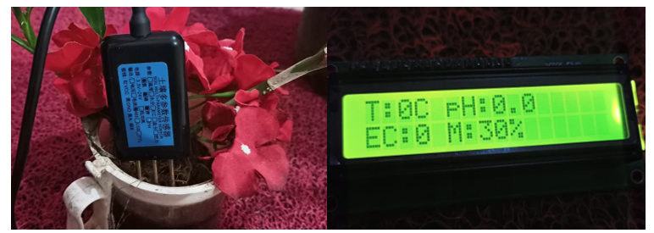
Experimental Output
Sample Output2:
MITE — MCA | AI Smart Agriculture | 2025–26
10 / 12

Slide 16
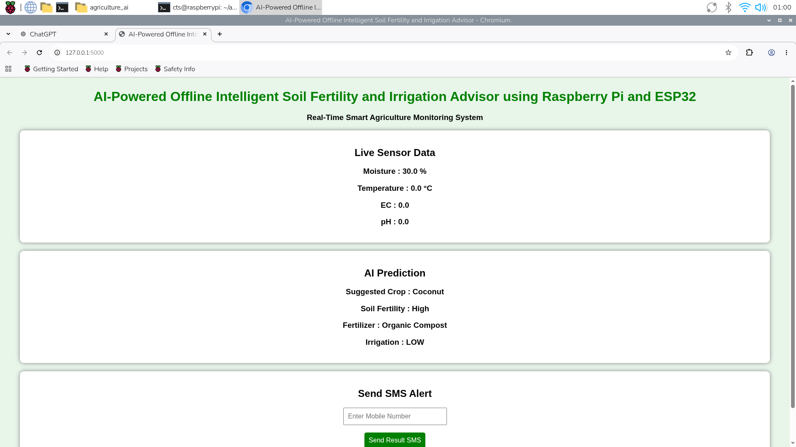
Experimental Output
Sample Output2:
MITE — MCA | AI Smart Agriculture | 2025–26
10 / 12

Slide 17
Conclusion
Low-cost solution using open-source hardware and software
Integrates IoT sensors, edge computing, machine learning, web dashboard, and SMS alerts
Offline-first design enables deployment in remote agricultural regions with limited internet connectivity
Provides real-time AI-driven recommendations for critical farm management decisions
Helps improve crop yield, optimize resource usage, and support sustainable farming practices
MITE — MCA | AI Smart Agriculture | 2025–26
10 / 12

Slide 18
Scope for Future Work
Ten directions for expanding the system
NPK-Specific Sensors
Weather Data Fusion
01
02
Add dedicated N, P, K sensors for granular fertilizer advice
Integrate local weather station for improved irrigation scheduling
Drone Multispectral Imaging
Mobile App (Android/iOS)
03
04
Field-wide soil health maps beyond point measurements
Connect to Raspberry Pi via Bluetooth/Wi-Fi for farmer UI
Region-Specific ML Datasets
Historical Data Logging
05
06
Karnataka agro-climatic zone specific crop & soil data
SQLite/InfluxDB for multi-season soil health trend analysis
Govt. Portal Integration
Solar + Battery Backup
07
08
Link with Agri Stack / PM-KISAN for benefit eligibility
100% energy-independent 24/7 remote deployment
TFLite / ONNX Models
Multi-Node Deployment
11 / 12
09
10
Deep learning models on Pi while maintaining offline operation
Central Pi aggregating data from multiple ESP32 field units

Slide 19
Thank You!
KEY TAKEAWAYS
✅ Offline-first AI — no cloud, no internet needed
✅ 4 ML models: Crop · Fertility · Fertilizer · Irrigation
✅ Real-time Modbus RS485 soil sensor + ESP32 + Raspberry Pi
✅ Web dashboard + SMS alerts for maximum farmer reach
✅ Affordable, scalable, ready for rural India deployment
Pranitha D Salian · Samuel Jesten Serrao · Prathik J Hegde · Sachin Shetty
Guided by Dr. Chandrakantha T S & Dr. Madhwaraj K G (HOD) | MITE — MCA | 2025–26

